Slide 1
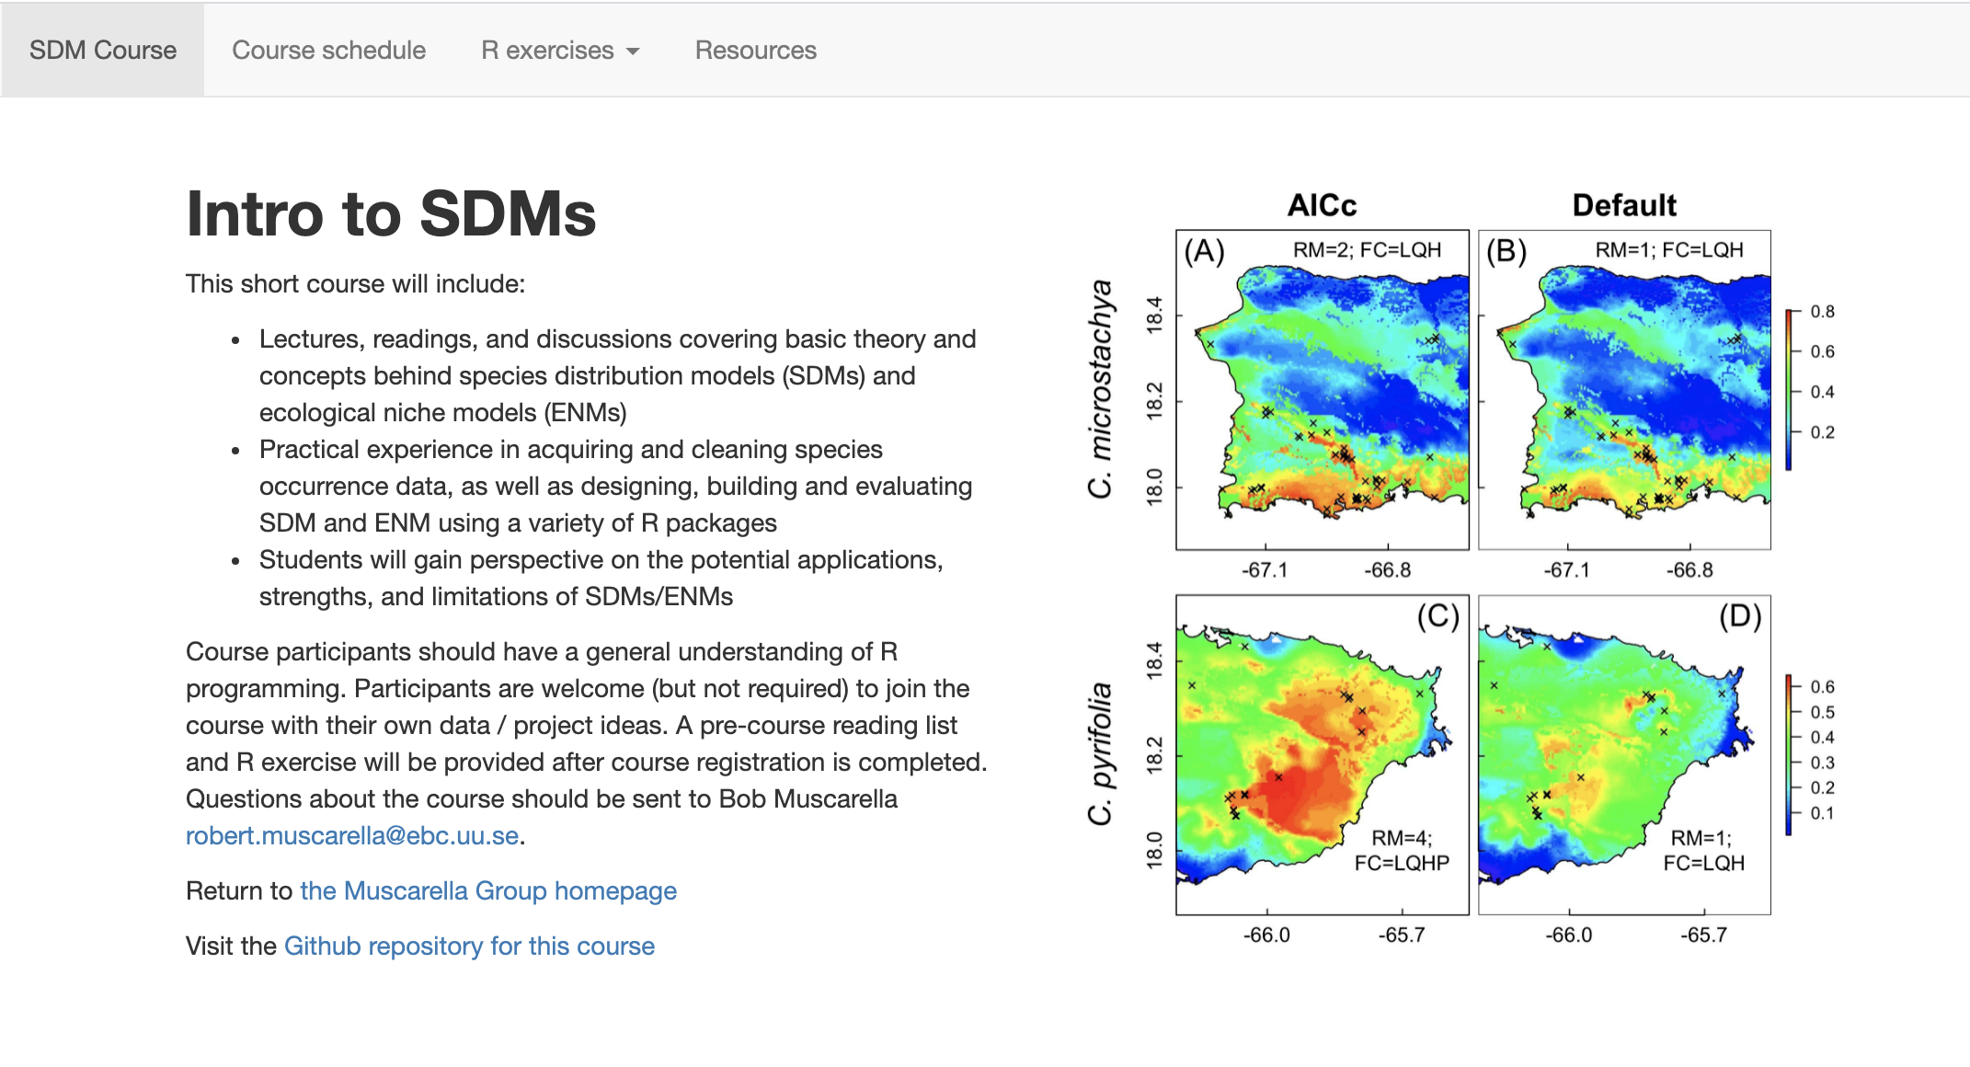
Introduction to SDMs:
Theory and practice in R
Bob Muscarella
Sapienza University, Roma
June 9-11
Course website: https://bobmuscarella.github.io/SDM-course/index.html

Slide 2
Who am I?
Associate professor in Plant Ecology & Evolution at Uppsala University
Tropical forest ecologist, (functional) diversity, forest dynamics, natural and anthropogenic disturbance
Interest in applying SDMs to understand broader context of diversity patterns, and how species respond to environmental conditions
Interest in methodological development of SDMs (ENMeval R package)

Slide 3


Course overview
3 day short course with emphasis on practical exercises
General understanding of main concepts + hands-on experience
Use these days as a spring board for continued learning
Not
like
this…
Like
this…

Slide 4

Learning objectives
Familiar with basic theory, concepts, and terminology of SDMs / ENMs
Design, build and evaluate SDMs / ENMs in R
Understand the strengths and limitations of SDMs / ENMs
Use SDMs/ENMs to describe and predict species distributions in space + time

Slide 5

Introductions (~ 2 min each)
Name?
Department?
Year of studies?
Research project?
Prior experience with R and SDMs?
What do you hope to gain from this course?
Anything else?

Slide 6

pausa caffè

Slide 7
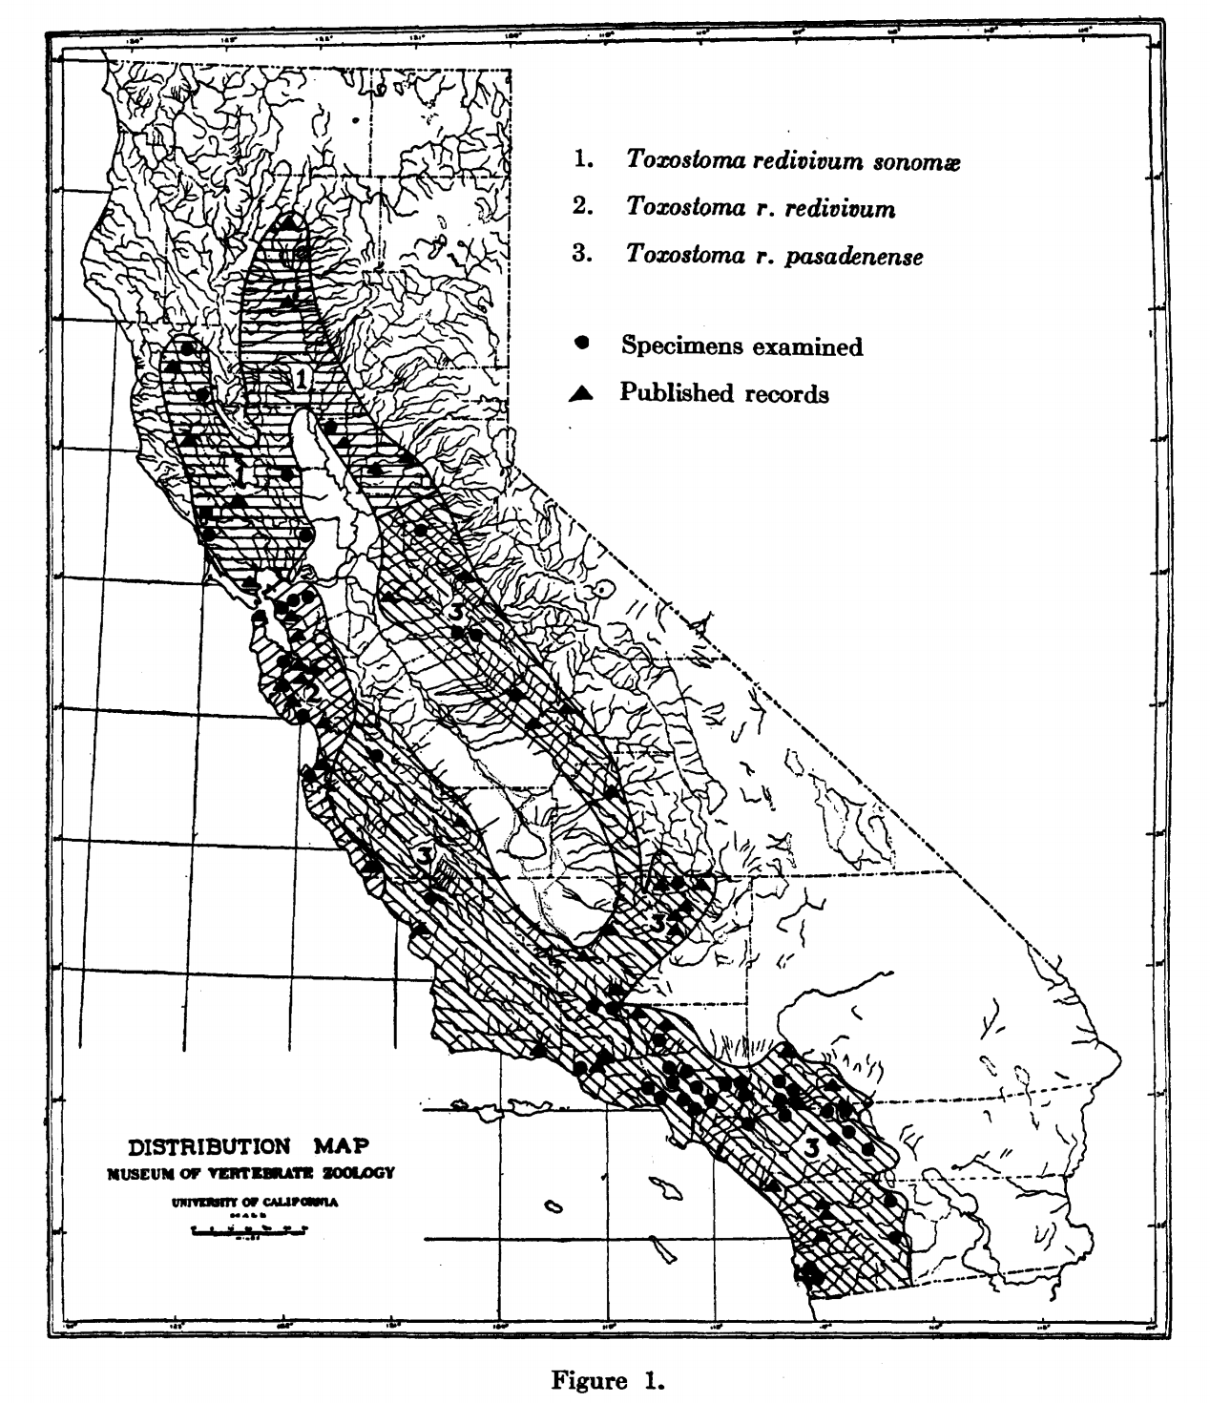
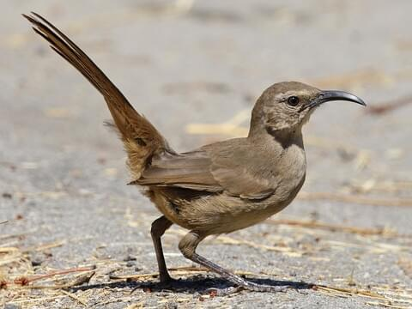
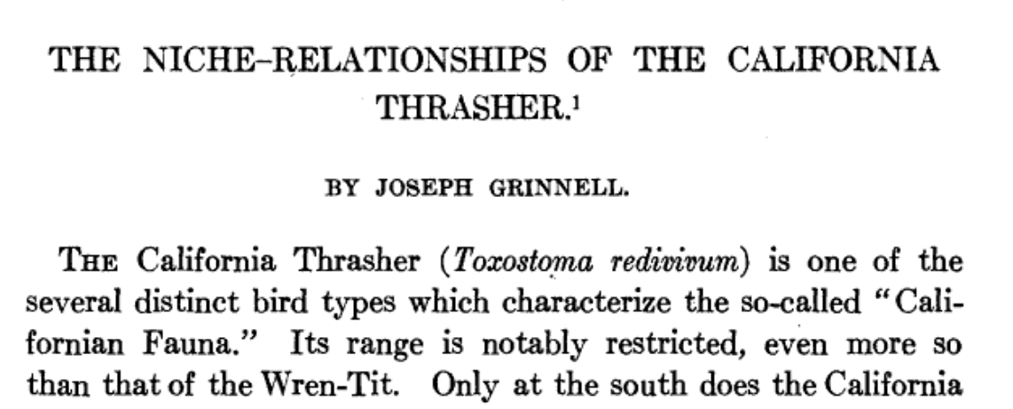
The what, how, why of SDMs/ENMs
Bob Muscarella
Sapienza University, Roma
June 9-11
Grinnell (1917) doi:10.2307/4072271

Slide 8
The what, how, why of SDMs/ENMs
What:
Models that describe the distribution of species across space or environmental gradients
How:
Develop statistical relationships between environmental conditions and locations where a species is present (and, in some cases, absent)
Why:
Address fundamental questions of ecology / evolution
Understand the potential exposure of species to environmental change
Develop solutions for applied problems in conservation, restoration, agriculture, forestry, etc.

Slide 9
The what, how, why of SDMs/ENMs
What:
Models that describe the distribution of species across space or environmental gradients

Slide 10
The what, how, why of SDMs/ENMs
What:
Models that describe the distribution of species across space or environmental gradients
ENMs (Ecological or Environmental niche models) focus on environmental space
SDMs (Species distribution models) focus on geographic space
Probability of species occurrence
Environment variable 1

Slide 11
The what, how, why of SDMs/ENMs
What:
Models that describe the distribution of species across space or environmental gradients
Environmental and geographic space
G space
E space

Slide 12
The what, how, why of SDMs/ENMs
What:
Models that describe the distribution of species across space or environmental gradients
Environmental and geographic space
E space
Variable 2
G space
Variable 1

Slide 13
“Probability of occurrence”
Occurrences
Geographic distribution
Juniperus communis
Larix decidua

Slide 14
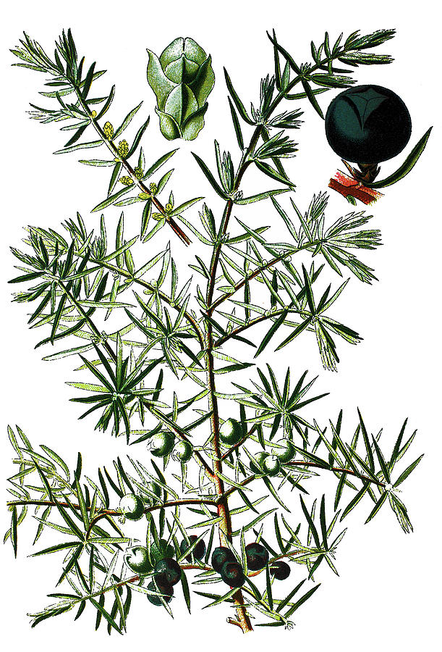
Juniperus communis
Distribution in ‘geographic space’
Distribution in ‘environmental space’
Annual precipitation (mm)
Annual average temperature (˚C)

Slide 15
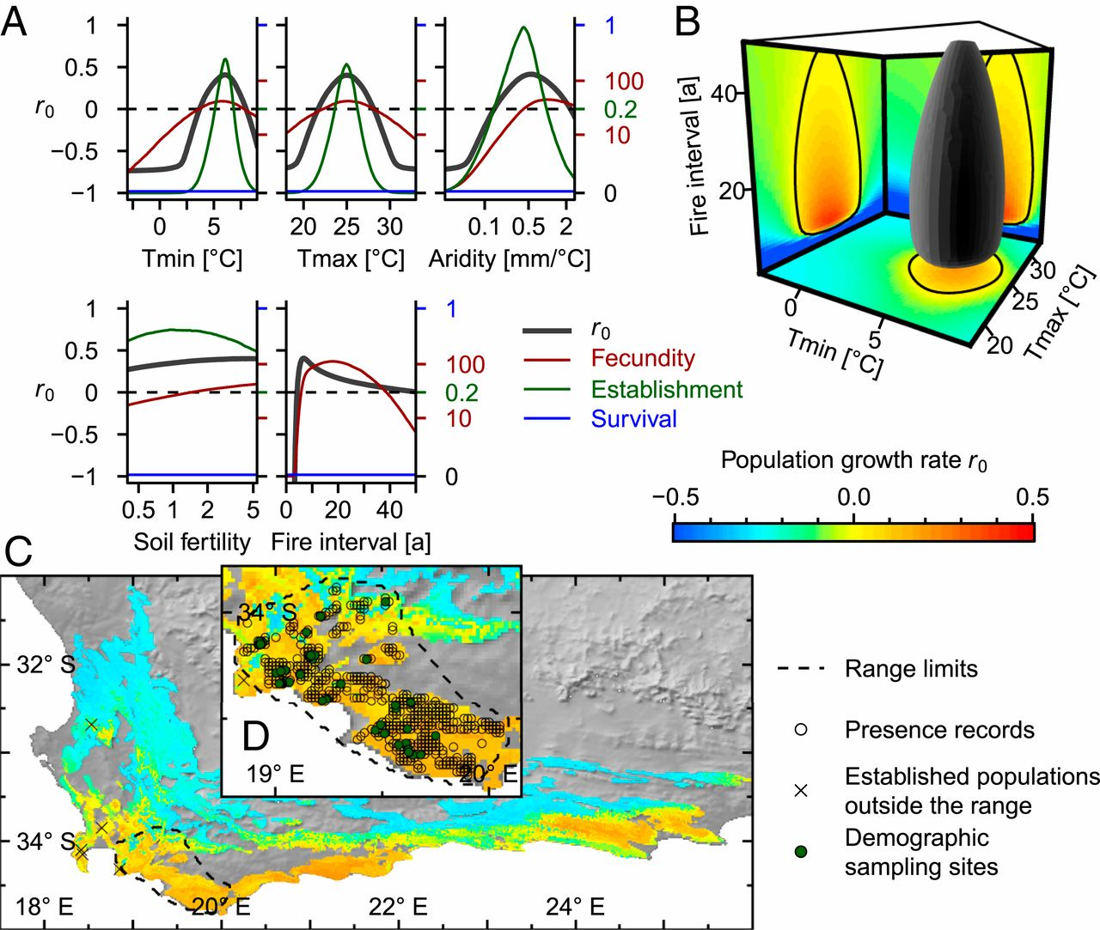
The what, how, why of SDMs/ENMs
What:
Models that describe the distribution of species across space or environmental gradients
Environmental and geographic space
Link between environmental conditions and fitness
Pagel et al. (2020) Proc. of the National Academy of Sciences. https://www.pnas.org/content/117/7/3663

Slide 16
The what, how, why of SDMs/ENMs
What:
Models that describe the distribution of species across space or environmental gradients
How:
Develop statistical relationships between environmental conditions and locations where a species is present (and, in some cases, absent)

Slide 17
The what, how, why of SDMs/ENMs
What:
Models that describe the distribution of species across space or environmental gradients
How:
Develop statistical relationships between environmental conditions and locations where a species is present (and, in some cases, absent)
Correlative vs. Mechanistic
Presence-absence vs. presence-only

Slide 18
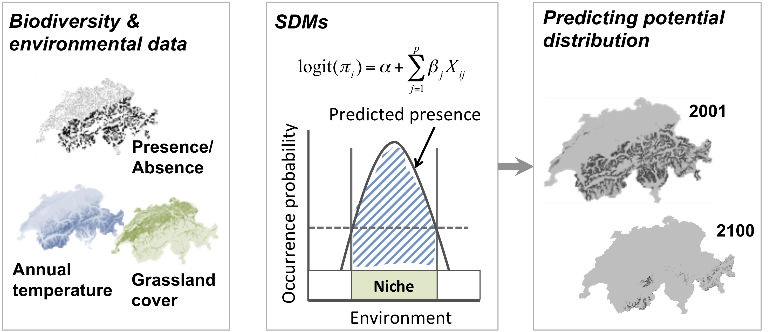
Correlative SDMs/ENMs
https://damariszurell.github.io/SDM-Intro/

Slide 19
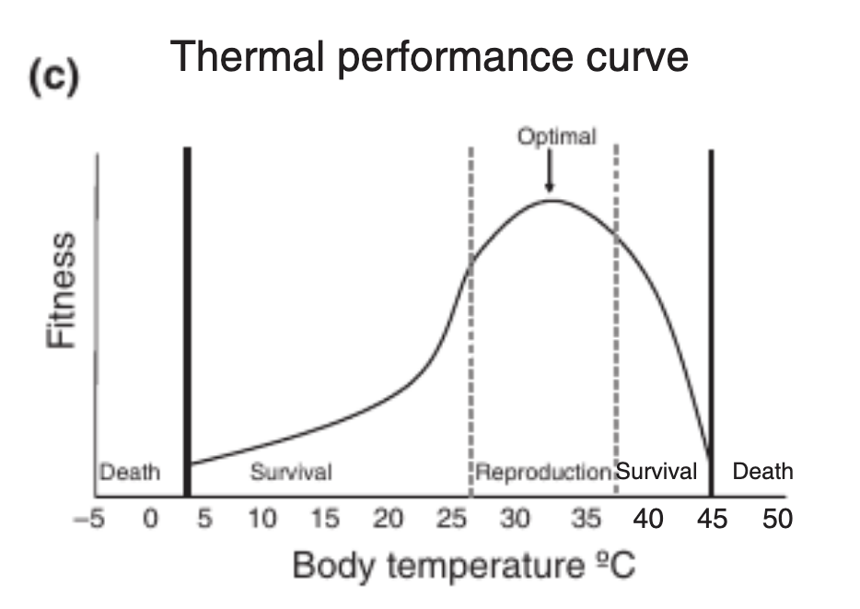
Mechanistic SDMs/ENMs
Fitness
Body temperature ˚C
Kearney and Porter (2009) Ecology letters 12 4: 334-50.

Slide 20
The what, how, why of SDMs/ENMs
What:
Models that describe the distribution of species across space or environmental gradients
How:
Develop statistical relationships between environmental conditions and locations where a species is present (and, in some cases, absent)

Slide 21
SDM / ENM workflow
Zurell et al. (2020) A standard protocol for reporting species distribution models. Ecography, 43, 1261-1277.

Slide 22
The what, how, why of SDMs/ENMs
What:
Models that describe the distribution of species across spatial or environmental gradients
How:
Develop statistical relationships between environmental conditions and locations where a species is present (and, in some cases, absent)*
Why:
Understanding / prediction
Address fundamental questions of ecology / evolution
Understand the potential exposure of species to environmental change
Develop solutions for applied problems in conservation, restoration, agriculture, forestry, etc.

Slide 23
The what, how, why of SDMs/ENMs

Slide 24
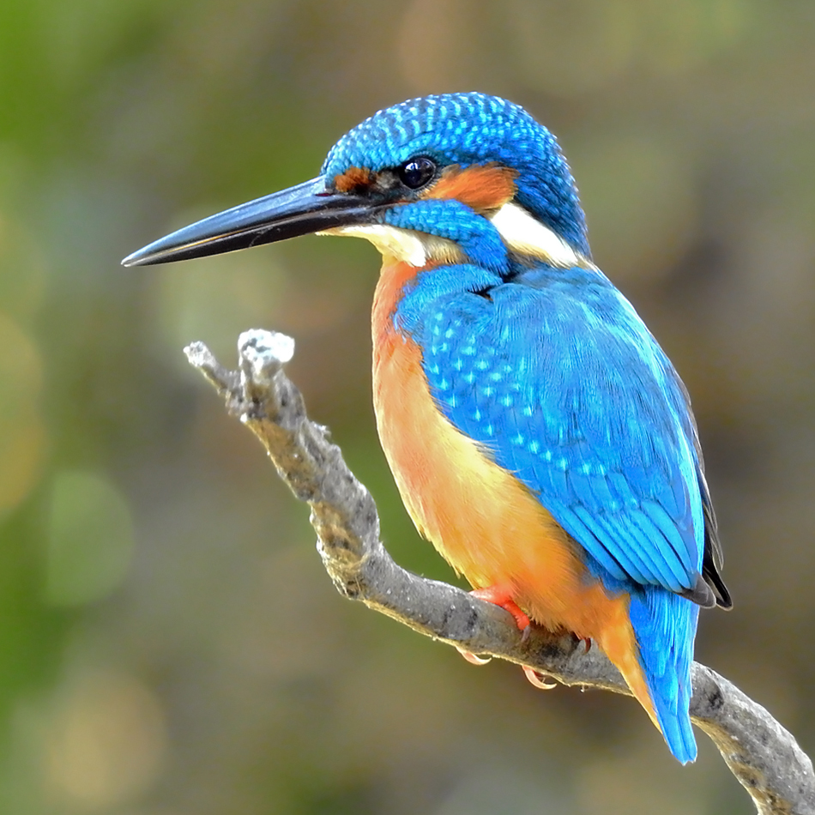
Who is where?
Common kingfisher (Alcedo atthis)
Photo: Shantanu Kuveskar

Slide 25
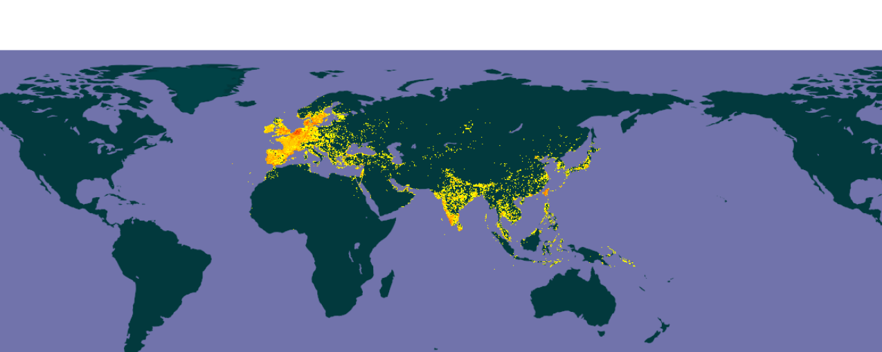
Who is where?
Common kingfisher (Alcedo atthis)
Occurrence observations
(e.g., https://www.gbif.org/)
Photo: Shantanu Kuveskar

Slide 26
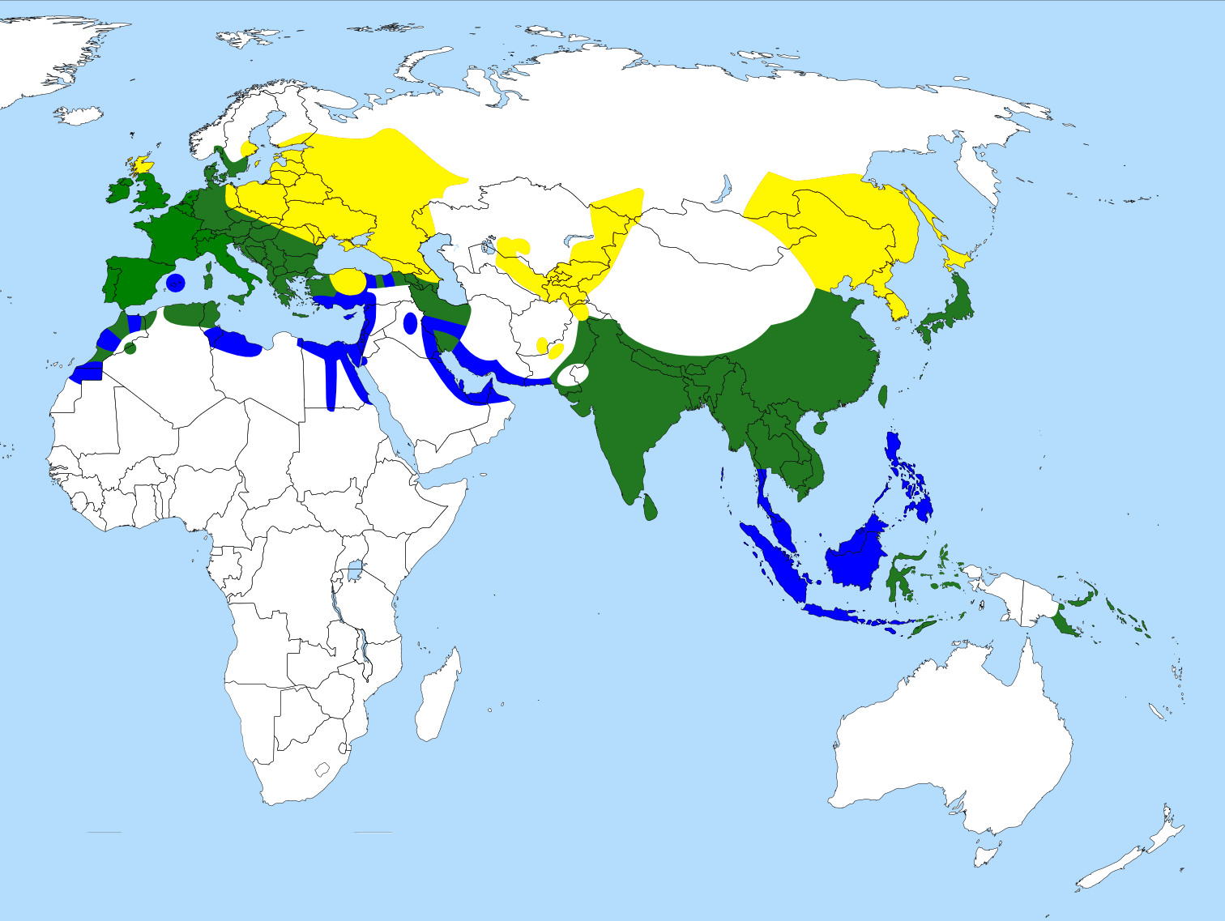
Who is where?
Common kingfisher (Alcedo atthis)
Occurrence observations
(e.g., https://www.gbif.org/)
Range map
Breeding range
Resident all year-round
Non-breeding range
Photo: Shantanu Kuveskar

Slide 27
Who is where?
Species observations
Checklists
Other studies
Herbarium collections
Other biological collections
Citizen science
Dataset | Link
ArtPortalen (Sweden) | https://www.artportalen.se/
Biodiversity Information Serving Our Nation (BISON) | https://bison.usgs.gov/
BioTime | http://biotime.st-andrews.ac.uk/home.php
Botanical Information and Ecology Network (BIEN) | http://bien.nceas.ucsb.edu/bien/
eBird | https://ebird.org/home
ForestGEO | https://forestgeo.si.edu/
ForestPlots.net | https://www.forestplots.net/
Global Biodiversity Information Facility (GBIF) | https://www.gbif.org/
iNaturalist | https://www.inaturalist.org/
International Union for the Conservation of Nature (IUCN) Redlist | http://www.iucnredlist.org/
Neotoma | https://www.neotomadb.org/
Paleobiology Database | https://paleobiodb.org/#/
PalmTraits | https://datadryad.org/stash/dataset/doi:10.5061/dryad.ts45225
Phylacine | https://datadryad.org/stash/dataset/doi:10.5061/dryad.bp26v20
USGS Breeding Bird Survey | http://www.pwrc.usgs.gov/BBS/
VertNet | http://vertnet.org/

Slide 28
Who is where?
Occurrence records are biased / incomplete samples in terms of taxonomy, geography, and time
Taxonomic Coverage
Geographic Coverage
Meyer et al. (2016) Multidimensional biases, gaps and uncertainties in global plant occurrence information. Ecology Letters, 19: 992-1006. doi:10.1111/ele.12624

Slide 29
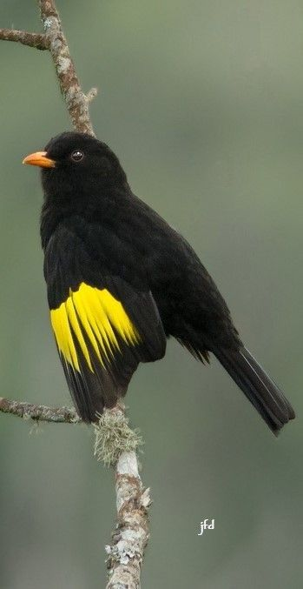
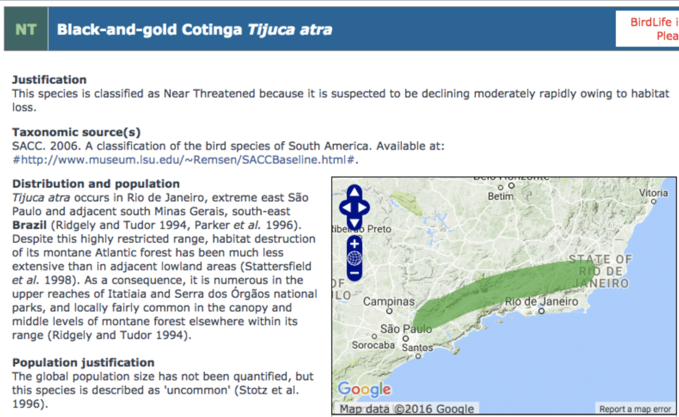
Understanding distributions is critical for conservation

Slide 30
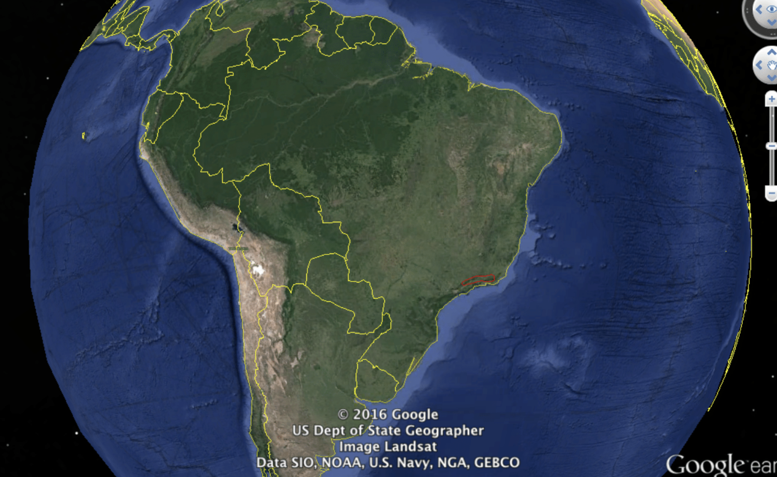

Slide 31
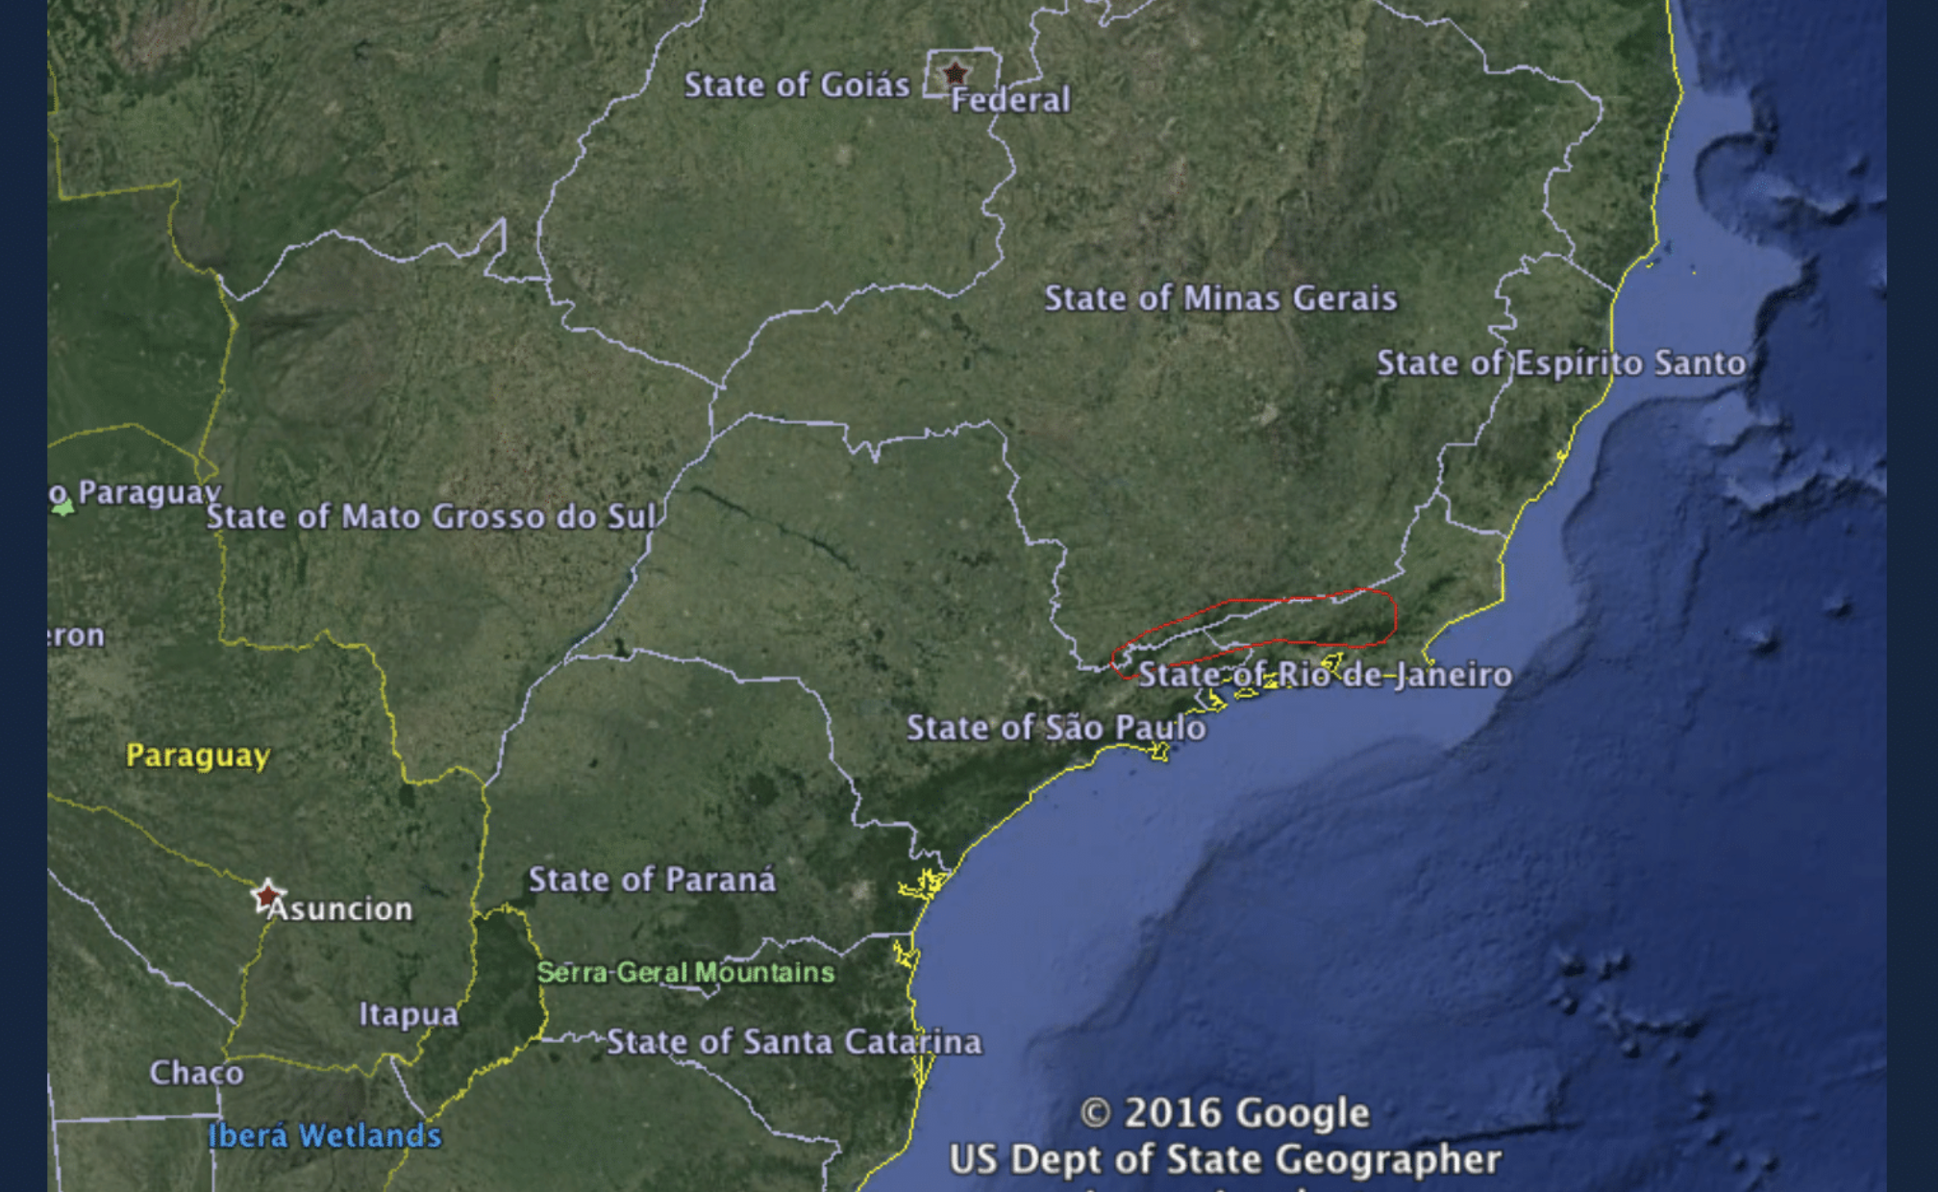

Slide 32
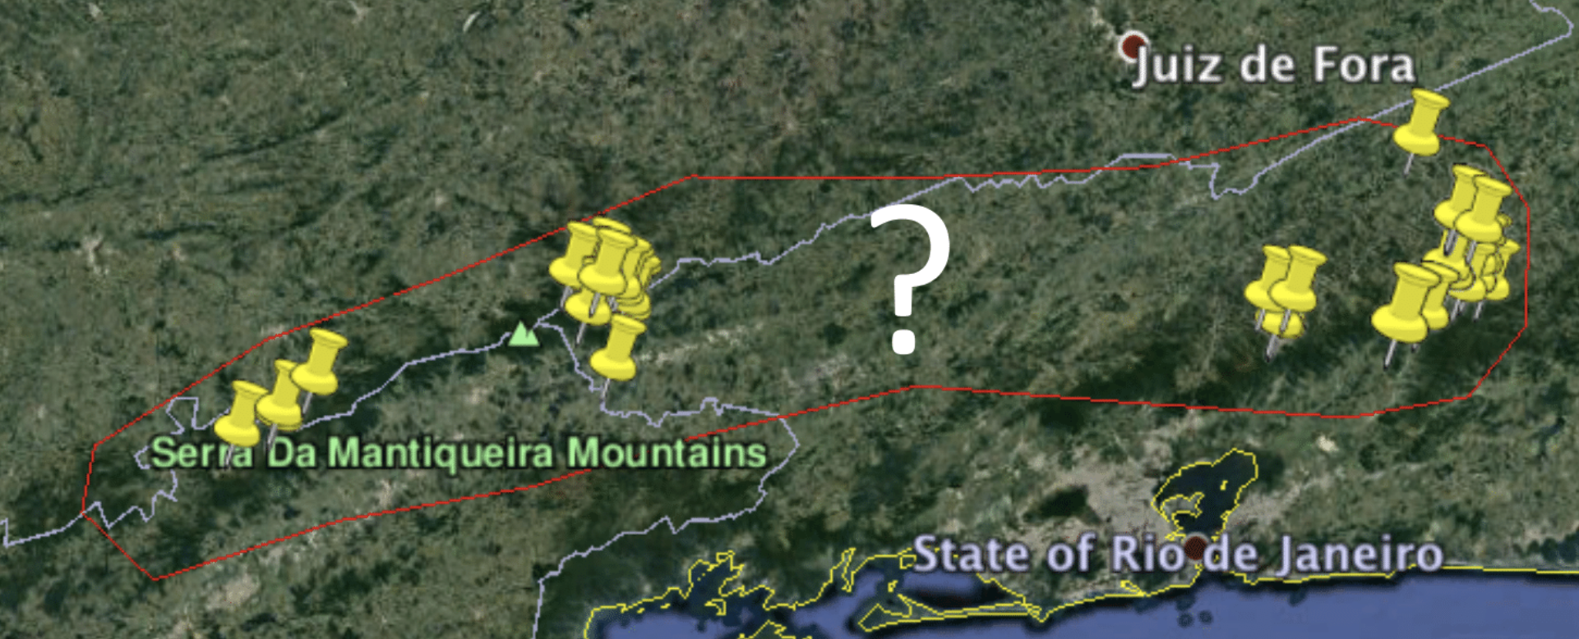

Slide 33
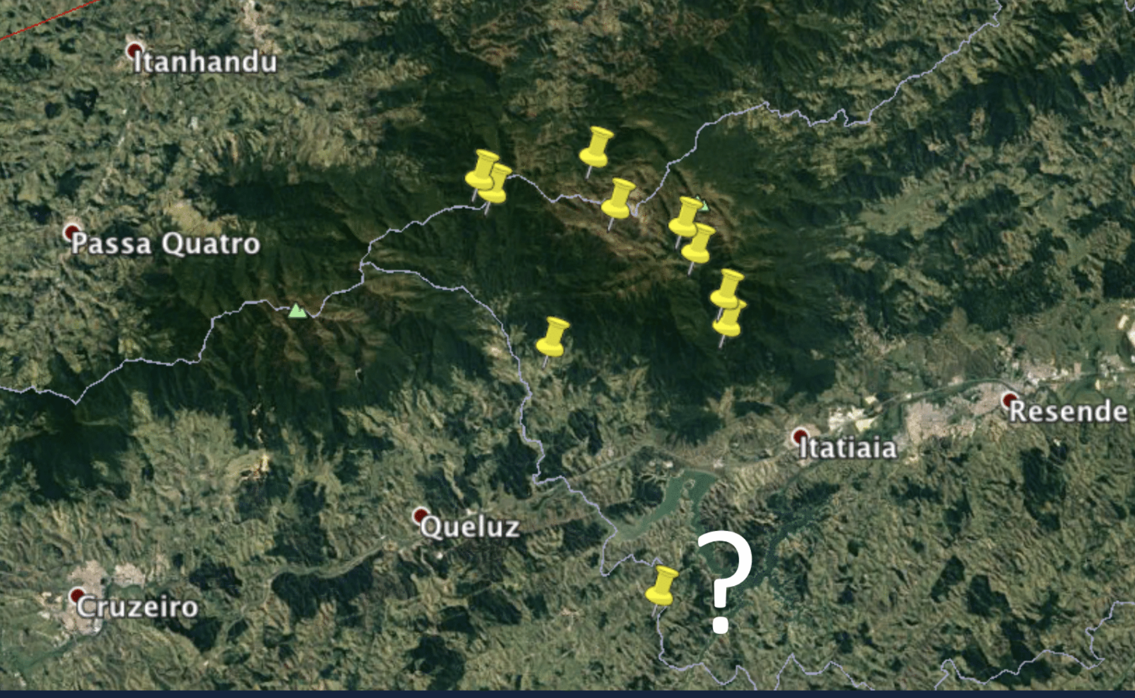

Slide 34
Challenges to understand distributions
Observations are biased in taxonomy, space, and time
Incomplete knowledge of species distributions
Errors and uncertainties in available data
Scale-dependency of all range mapping phenomena
In reality, “species” and “distributions” are not homogeneous entities

Slide 35
Who is where?
And why?
Absent
Present

Slide 36
Who is where?
And why?
Accessible (movement)
Short-term movement
Long-term dispersal
Geographic barriers
Accessible

Slide 37

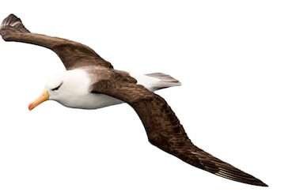
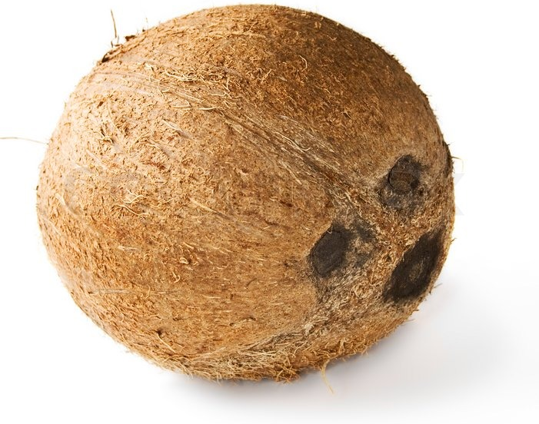

Organisms move
(in different ways and at different rates!)

Slide 38
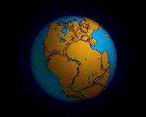
Geology happens
Hoorn et al. (2010) Amazonia Through Time: Andean Uplift, Climate Change, Landscape Evolution, and Biodiversity. Science 12: 927-931.

Slide 39
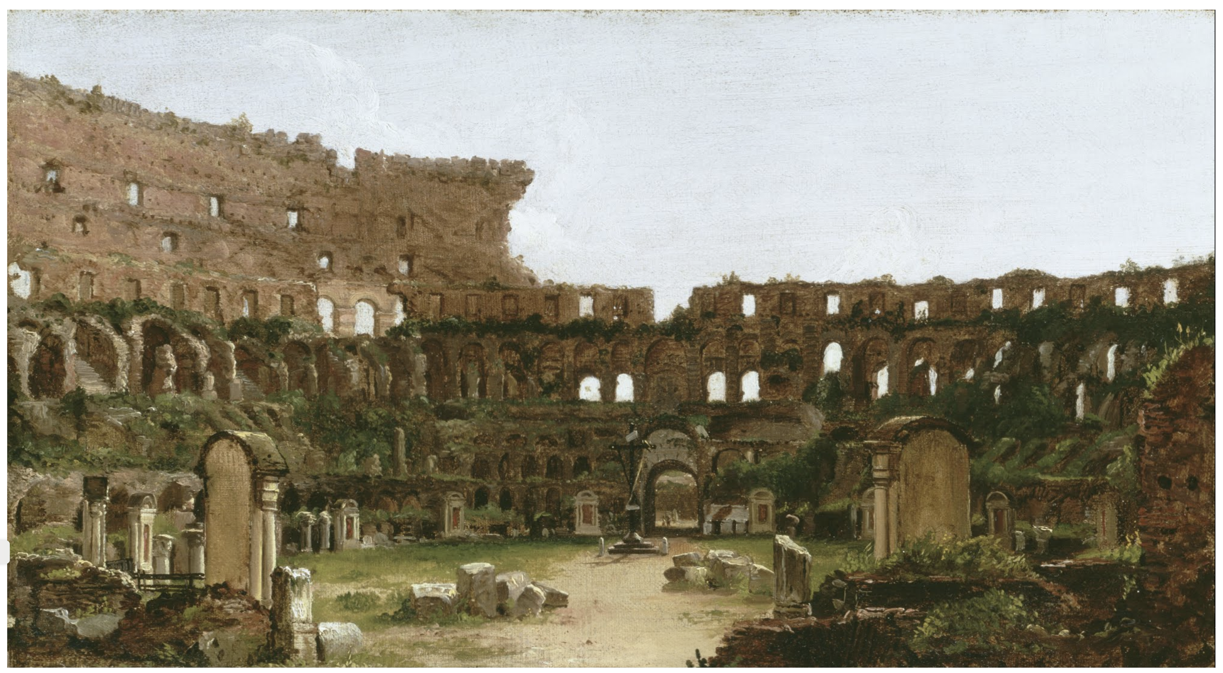
Human-assisted migration
When the botanist Richard Deakin examined Rome’s Colosseum in the 1850s, he found 420 plant species growing among the ruins. Some of them were not found anywhere else in Europe!
https://www.theatlantic.com/science/archive/2017/12/romes-colosseum-garden/547535/#:~:text=When%20the%20botanist%20Richard%20Deakin,and%2056%20varieties%20of%20grass.

Slide 40
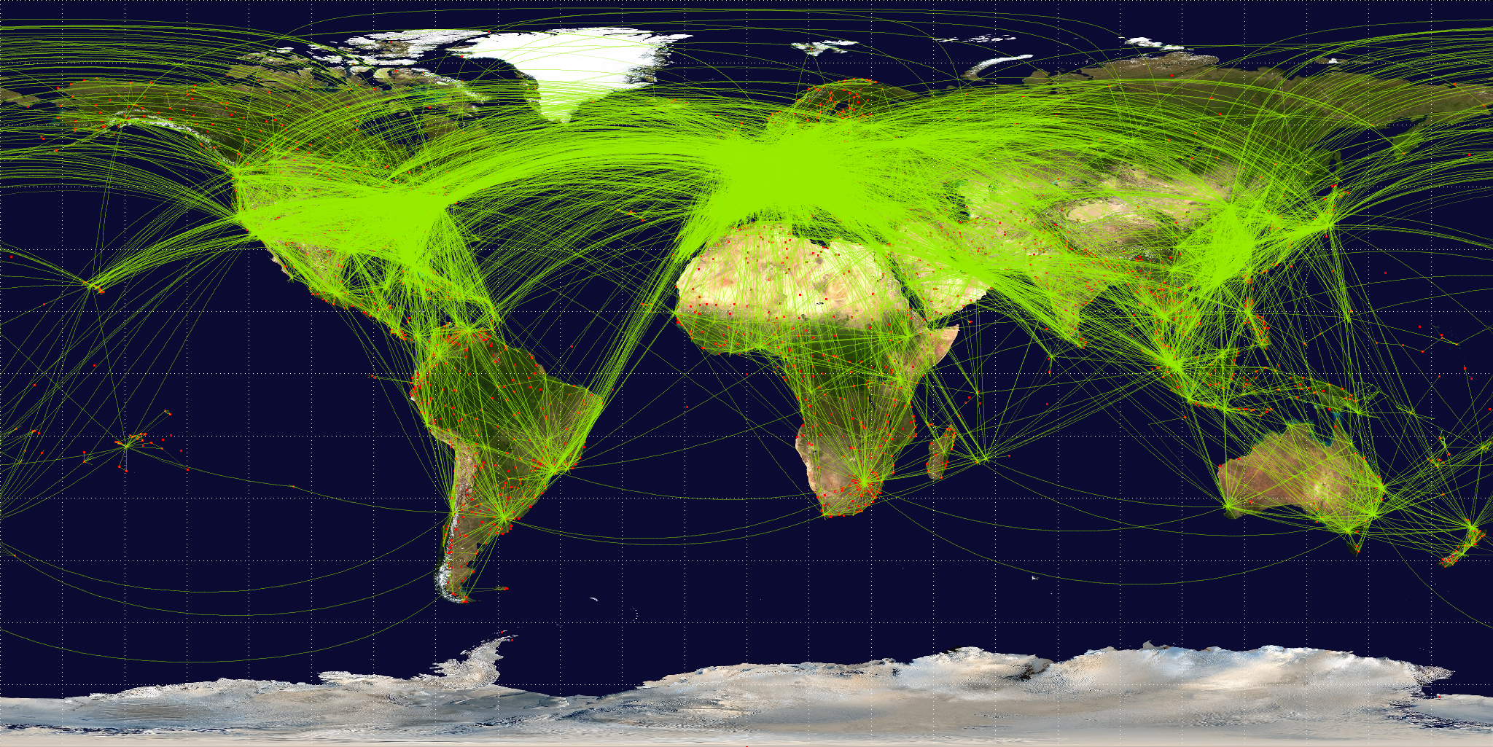

Slide 41
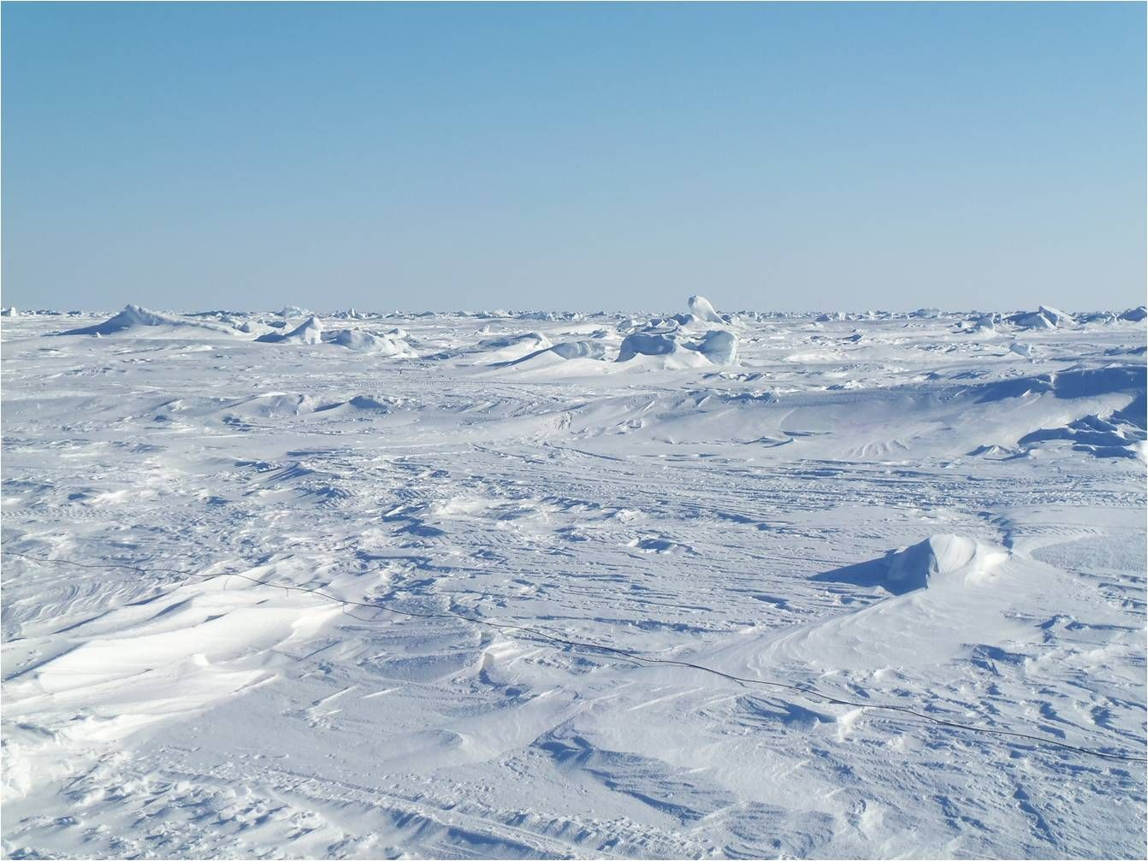


Slide 42
Who is where?
And why?
Abiotic
Accessible (movement)
Physiological tolerance (abiotic)
Climate
Soil / water chemistry
Nutrients
Accessible

Slide 43
Biomes of Earth
Distributions of biomes are largely explained by mean annual rainfall and temperature
Notes:
Or we might think very locally about how patterns of plant community composition vary within a single forest stand.

Slide 44
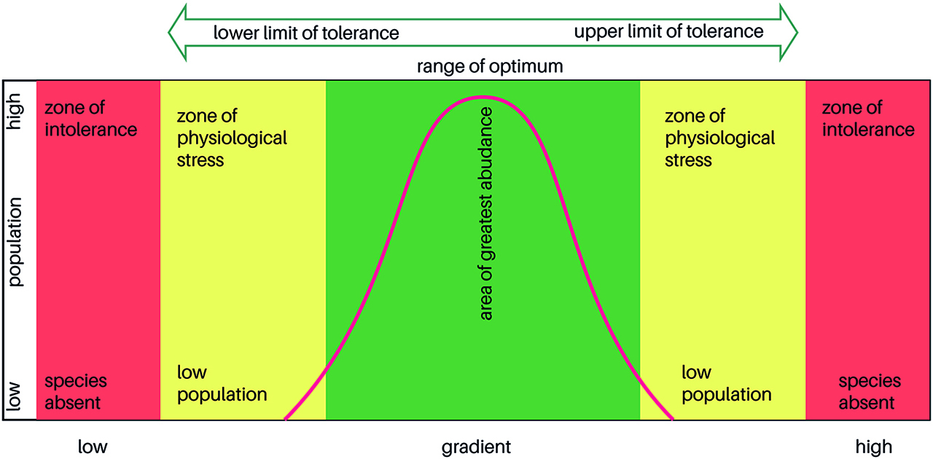
Who is where?
And why?
Accessible (movement)
Physiological tolerance (abiotic)

Slide 45
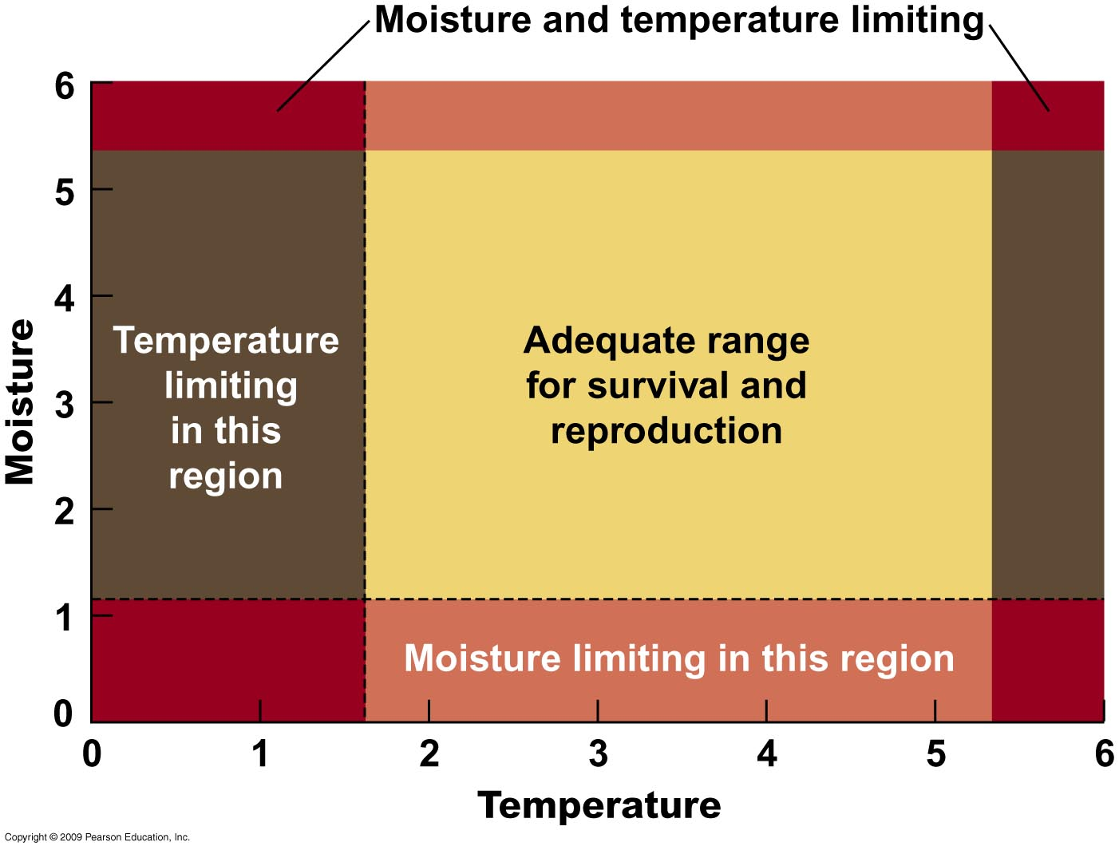
Who is where?
And why?
Accessible (movement)
Physiological tolerance (abiotic)

Slide 46
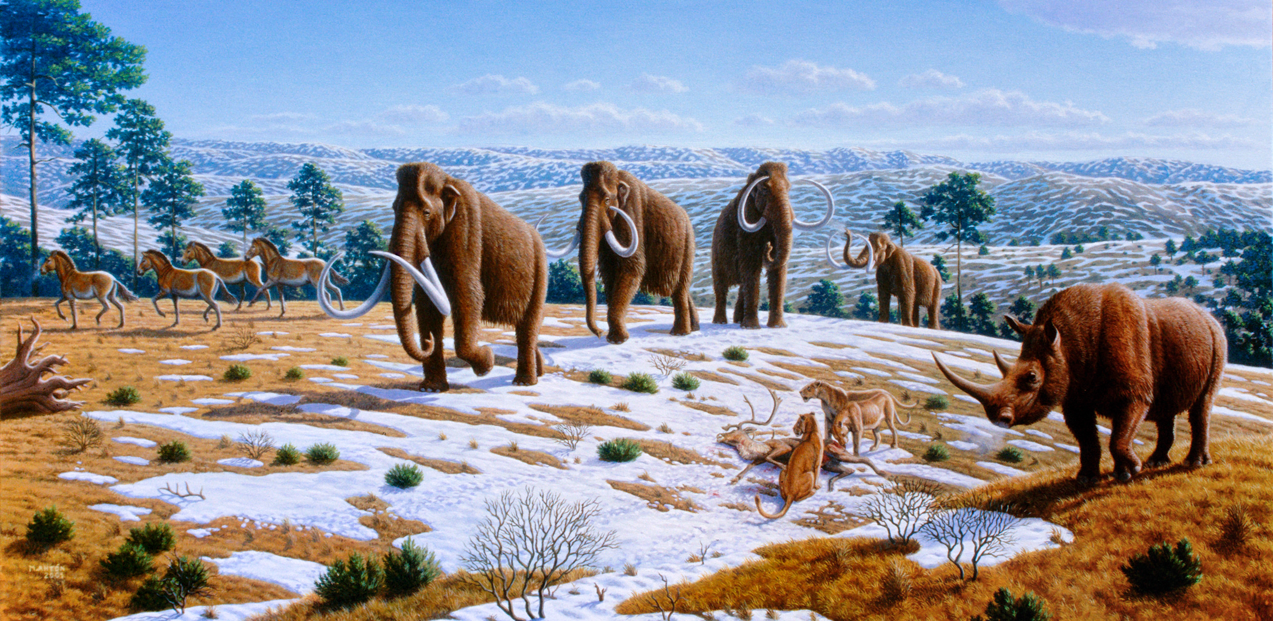
Who is where?
And why?
Europe during the last glacial maximum
Megafauna in Spain during last glacial maximum

Slide 47
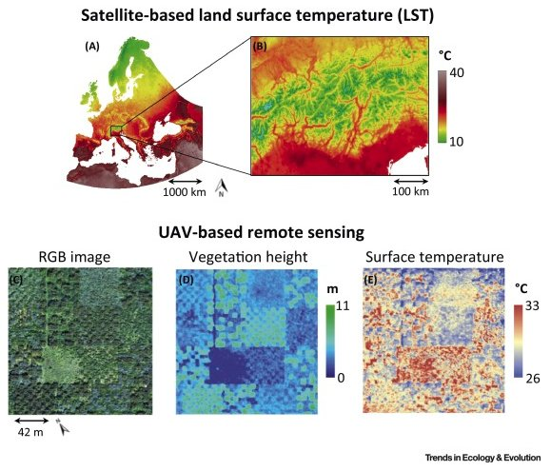
Satellite-based land surface temperature
Microclimate matters
UAV-based remote sensing
C. Körner
Zellweger et al. (2019) Advances in Microclimate Ecology Arising from Remote Sensing. Trends in Ecology & Evolution 34: 327-341.

Slide 48
Who is where?
And why?
Abiotic
Accessible (movement)
Physiological tolerance (abiotic)
Biotic interactions
Competition
Predators / Prey
Parasites
Mutualists
Pollinators
Soil symbionts
Facilitators
Dispersal
Biotic
Accessible

Slide 49
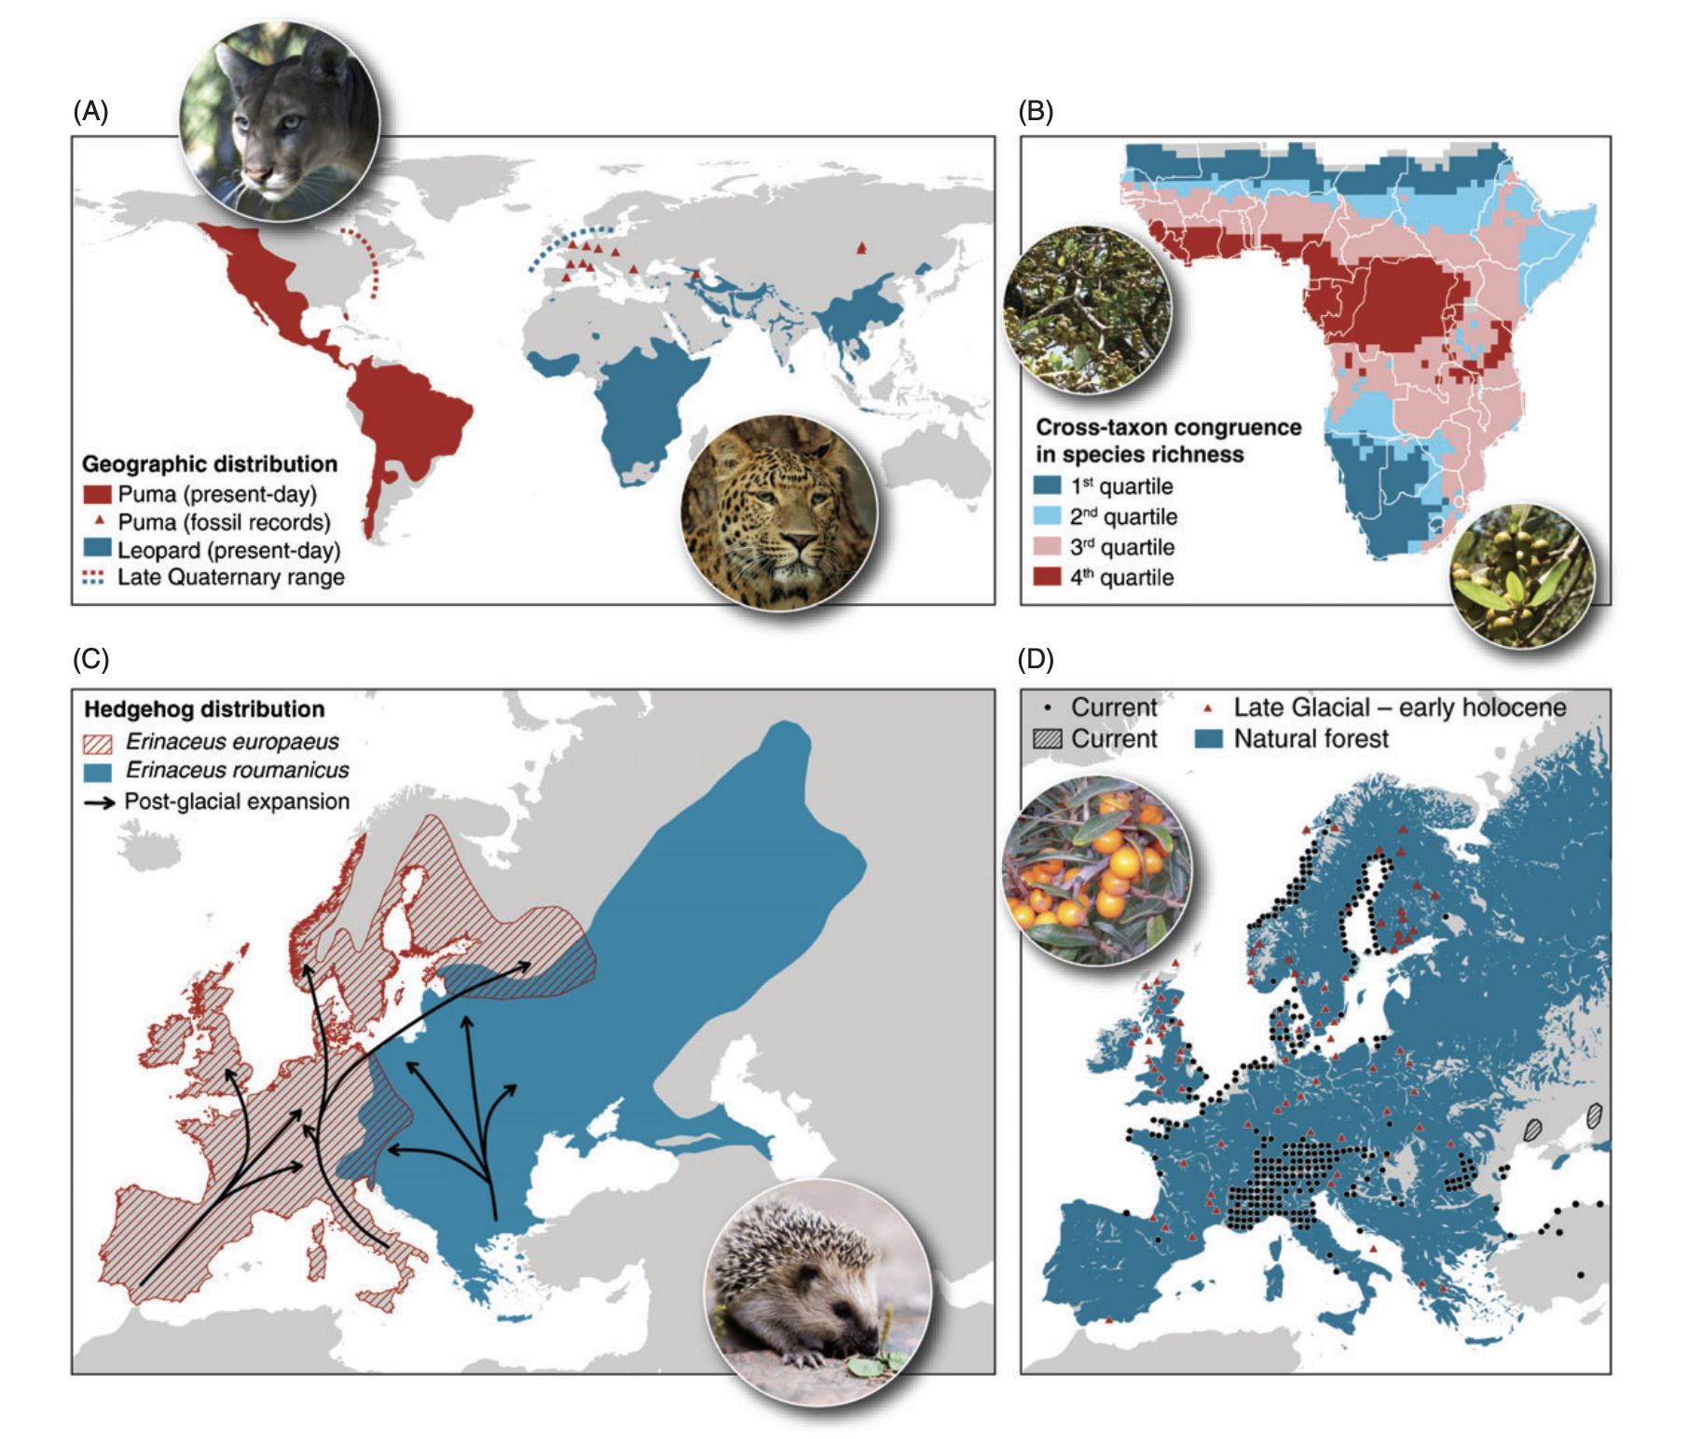
Who is where?
And why?
Accessible (movement)
Physiological tolerance (abiotic)
Biotic interactions
Biotic interactions can
affect distributions
Wisz et al. (2013) The role of biotic interactions in shaping distributions and realised assemblages of species: implications for species distribution modelling. Biological Reviews 88: 15-30.

Slide 50
BAM
diagram
Who is where?
And why?
Abiotic
Accessible (movement)
Physiological tolerance (abiotic)
Biotic interactions
Biotic
Accessible

Slide 51
Potential distribution
Who is where?
And why?
Abiotic
Accessible (movement)
Physiological tolerance (abiotic)
Biotic interactions
Biotic
Accessible

Slide 52
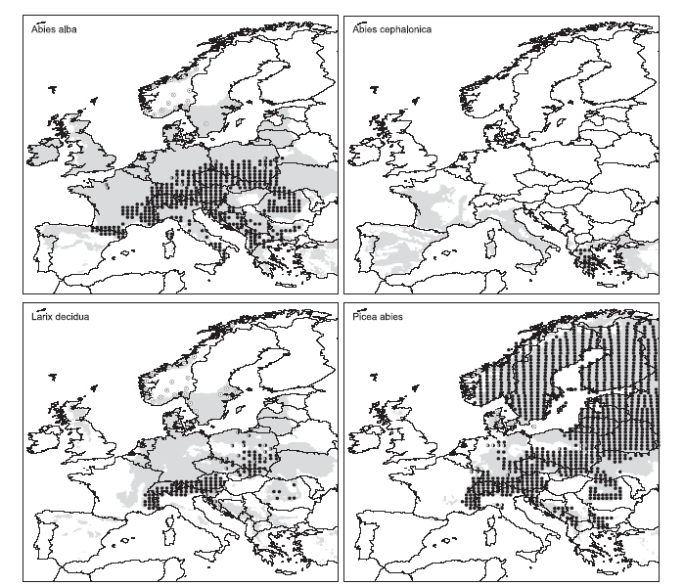
Limited filling of the potential range in European tree species
Native
Naturalized
Potential
Climatic range
Svenning & Skov (2004) Ecology Letters. Limited filling of the potential range in European tree species
Notes:
Observed distribution according to Atlas
native (black circles), naturalized (i.e. established alien; empty circles), extinct or probably extinct (cross), and present, but of doubtful or unknown status, e.g. whether native or alien (half-filled circles).

Slide 53
Who is where?
And why?
Realized
distribution
- or -
‘realized niche’
Abiotic
Accessible (movement)
Physiological tolerance (abiotic)
Biotic interactions
Biotic
Movement

Slide 54

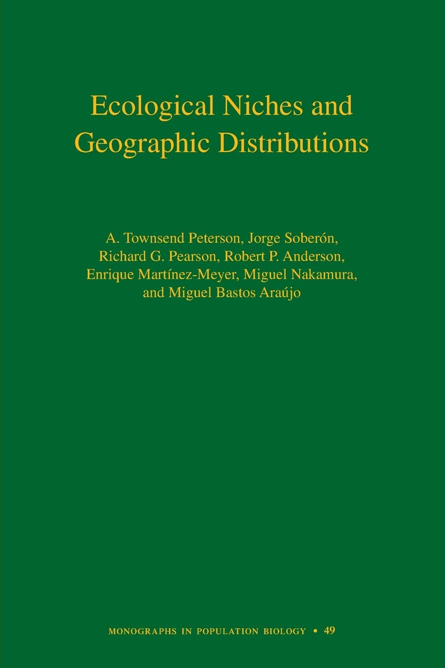
The Ecological Niche
Broadly defined as the conditions where a species can exist (spatial, temporal, behavioral, etc.)
Multivariate and complex, (e.g., life stages, above / below-ground, etc.)
The ecological niche is a scientific construction – NOT a specific place
Multiple definitions and hotly debated!

Slide 55
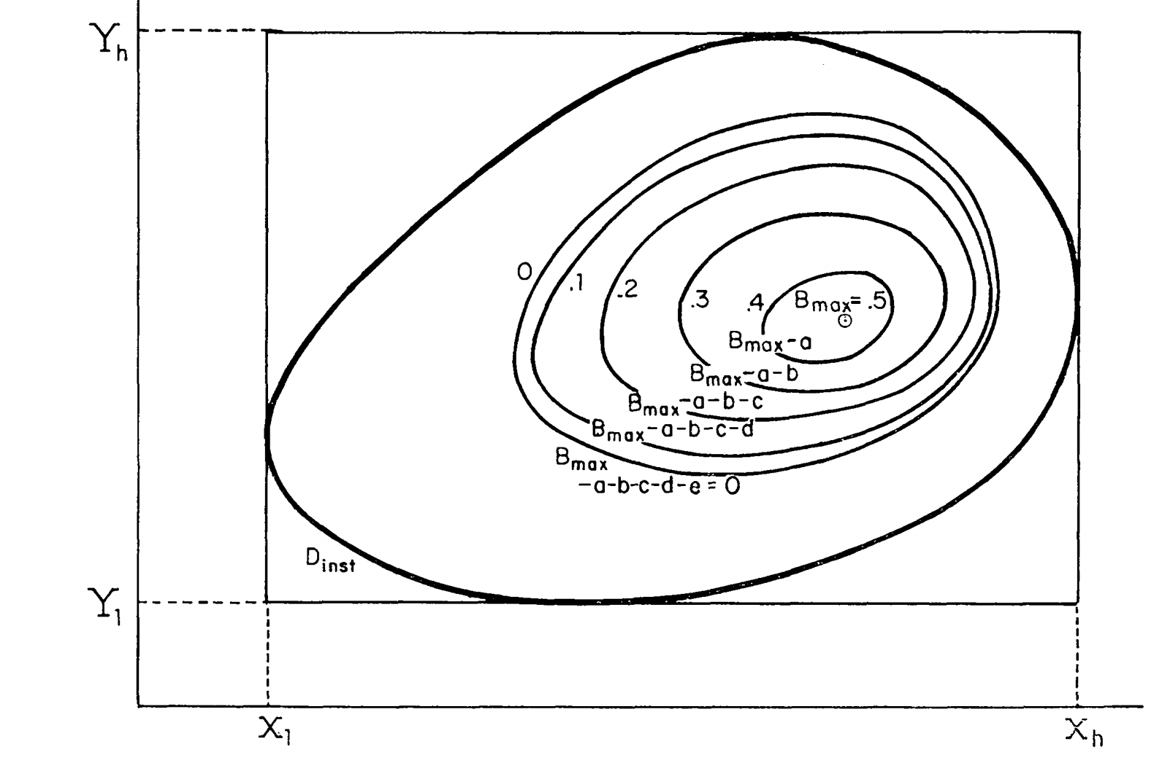
The Ecological Niche as a fitness landscape
Maguire (1973) proposed niches should have a structure measured in fitness
Maguire (1973) The American Naturalist. http://www.jstor.org/stable/2459795
Pagel et al. (2020) Proc. of the National Academy of Sciences. https://www.pnas.org/content/117/7/3663

Slide 56
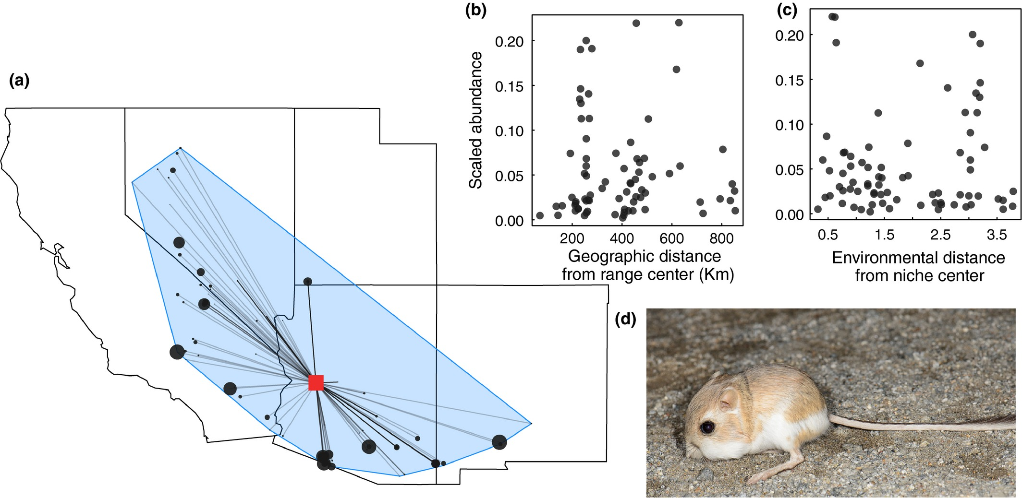
The ‘Abundant Center’ Hypothesis
For >1,400 species of birds, trees, mammals, fishes:
Abundance
Distance from niche center
Dallas et al. (2017) Species are not most abundant in the centre of their geographic range or climatic niche. Ecology Letters. 10.1111/ele.12860

Slide 57
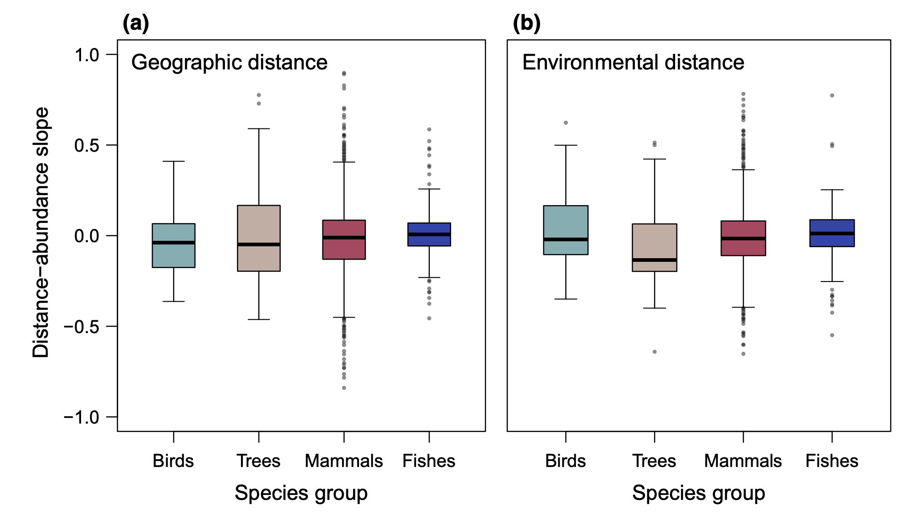
The ‘Abundant Center’ Hypothesis
Abundance
Distance from niche center
Dallas et al. (2017) Species are not most abundant in the centre of their geographic range or climatic niche. Ecology Letters. 10.1111/ele.12860

Slide 58
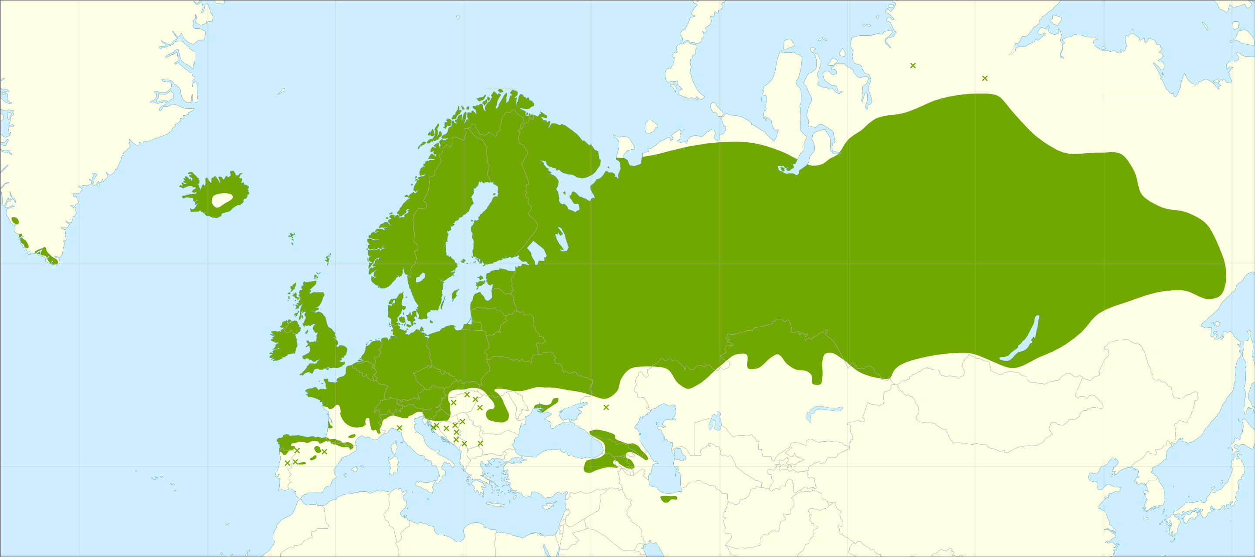
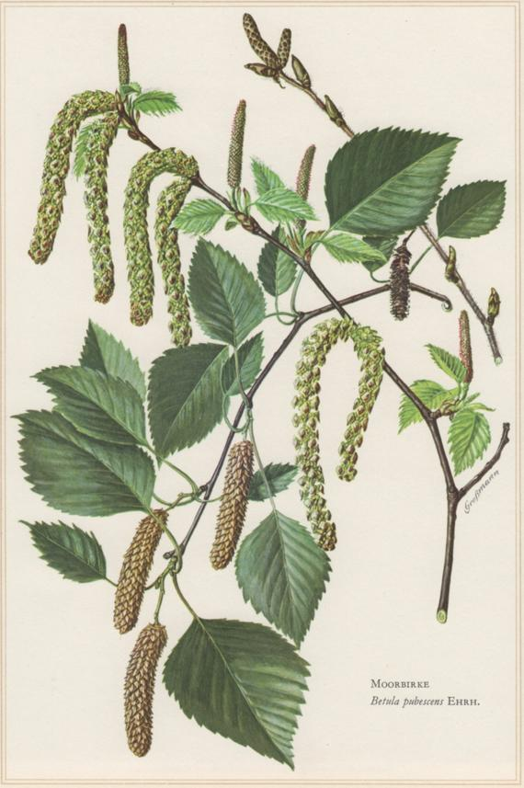
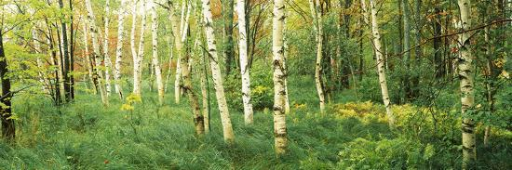
Birch (Betula pubescens)

Slide 59
Birch (Betula pubescens)
Annual precipitation (mm)
Annual average temperature (˚C)

Slide 60
Birch (Betula pubescens)
Northern
Sweden
Southern
Sweden
Annual precipitation (mm)
Annual average temperature (˚C)

Slide 61
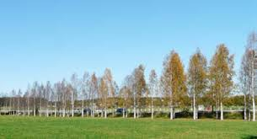
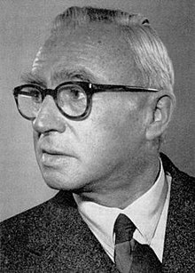
Intraspecific variation and ecotypes Turesson’s birches
Dag Hammarskjölds Väg, across from SLU
Scania
(Southern Sweden)
Lappland
(Northern Sweden)
Göte Turesson
(1892 – 1970)

Slide 62
Summary
Species distributions + niches are scale-dependent and estimated from imperfect data
Species distributions + niches are governed by a combination of accessibility, abiotic conditions, and biotic interactions
Species distributions + niches are dynamic and change in space / time
Abundance + fitness vary in complex ways across a species’ distribution + niche

Slide 63
Questions?
Henri Rousseau, The Hungry Lion Throws Itself on the Antelope, 1905

Slide 64
Small group discussions of pre-course readings
What did you find most interesting / confusing?
What seems to be the most challenging aspect of building species distribution model?
(after lunch: R Exercises 1 & 2)
Henri Rousseau, The Hungry Lion Throws Itself on the Antelope, 1905

